Slide 1
Design Thinking
August 7th, 2017

Slide 2
The Design Process

Slide 3

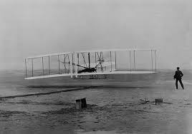


Why do we need design?

Slide 4
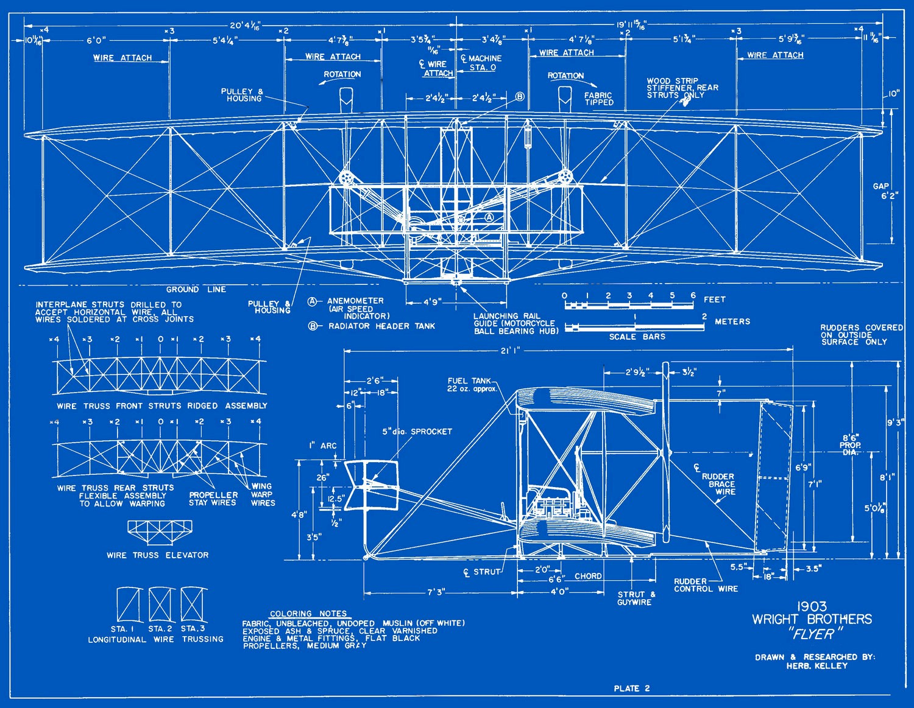
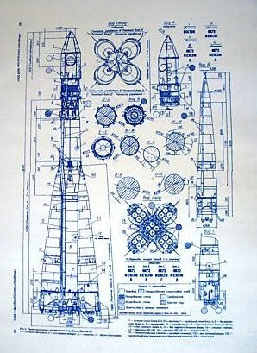
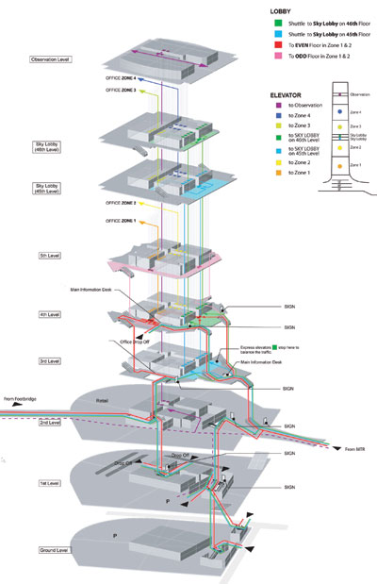
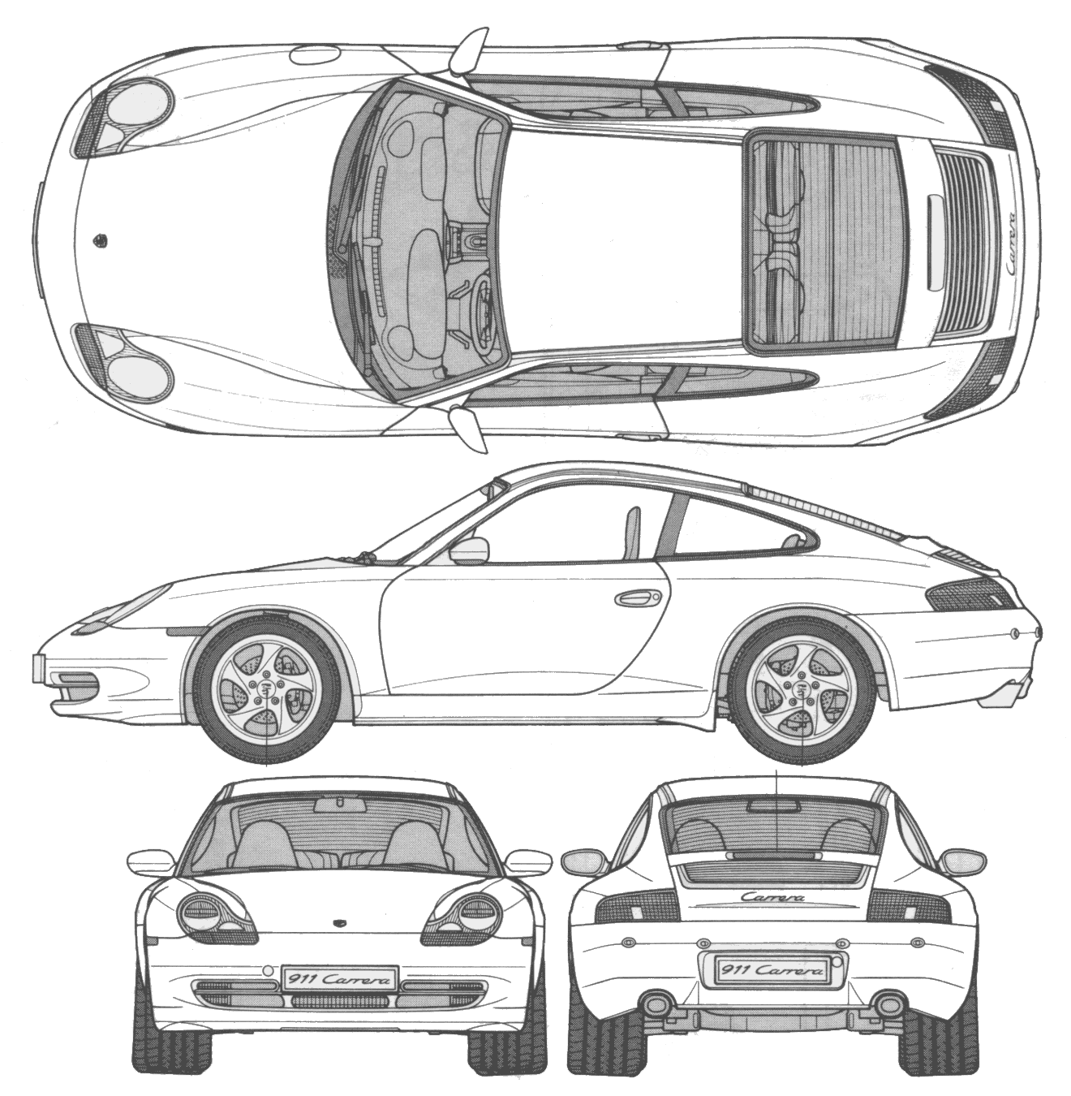
A lot comes before the finished product

Slide 5
Designing is a Process!
Empathize
Define
Brainstorm
Prototype
Test

Slide 6
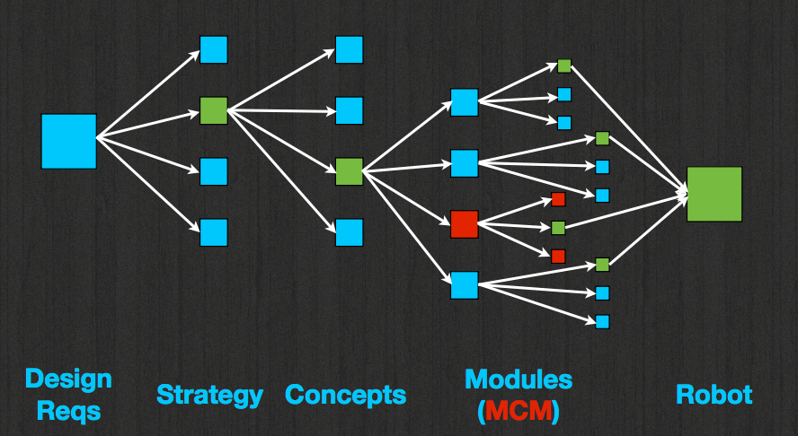
Designing is a Process!
Define
Identify your modules

Slide 7
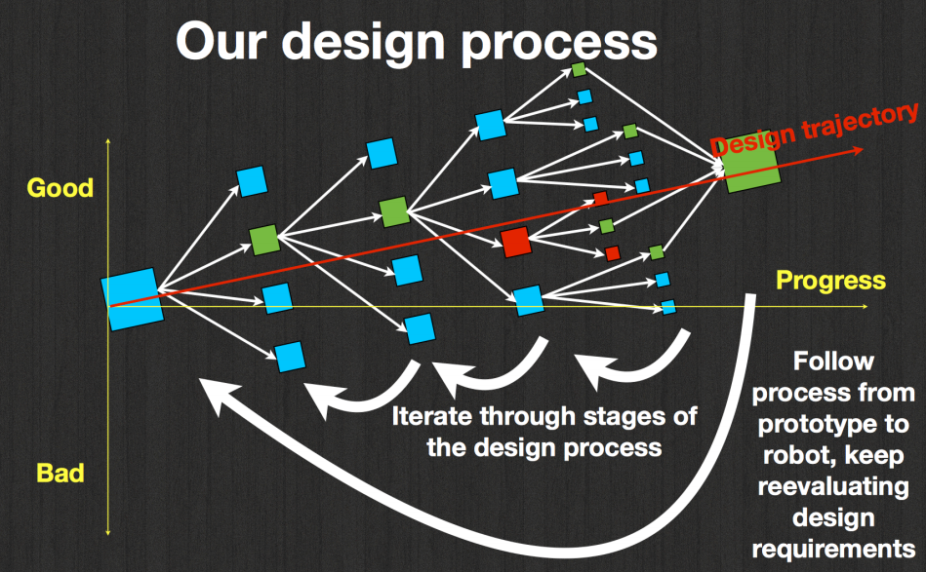
Fail! Early and Often

Slide 8
Key Players in the Design Process
Prototypes (2 kinds) with simple materials
Models- drawings, computer
Talking with peers, exchanging ideas
Calculations to verify
Always think back to the big picture and design requirements

Slide 9
Now It’s Your Turn!
Brainstorming is a key step for design
No idea is a bad ideas (more ideas = better!)
Focus on QUANTITY not quality
Include a rough sketch of each idea, and a few words
Think outside the box, it doesn’t have to make sense
Have fun!

Slide 10
What is the best way to get the paper ball from the ground to the table?
Focus on DESIGN (not materials), what is important here?

Slide 11
Ideas
How do you narrow these down?
Notes:
Brainstorming is something that you can practice - you can get better at it! Try thinking about new ideas throughout your day.

Slide 12
Pugh Chart
Ideas

Slide 13
Next Steps
Prototyping (foam core, cardboard, construction paper)
Cheap, efficient
Helps to visualize the end result
Calculations
Is this feasible?
Is this reasonable?
Start designing
Many iterations, that’s ok!
“Measure twice, cut once”

